Slide 1

307102 Descriptive Statistics for Business
Introduction to Linear Regression
2024-2

Slide 2
Introduction to Regression Analysis
Definition: Regression analysis is a powerful statistical method used for predicting a dependent variable based on one or more independent variables.
Purpose: To understand how the typical value of the dependent variable changes when any one of the independent variables is varied, while the other independent variables are held fixed

Slide 3
Types of Regression
Simple Linear Regression: Involves one independent variable and one dependent variable and the relationship between them is modeled by a linear function.
Multiple Linear Regression (Focus of this presentation): Involves multiple independent variables influencing a single dependent variable.
Other Types: Logistic regression, polynomial regression, Ridge Regression, Lasso Regression etc., used for more specific types of data and relationships.

Slide 4
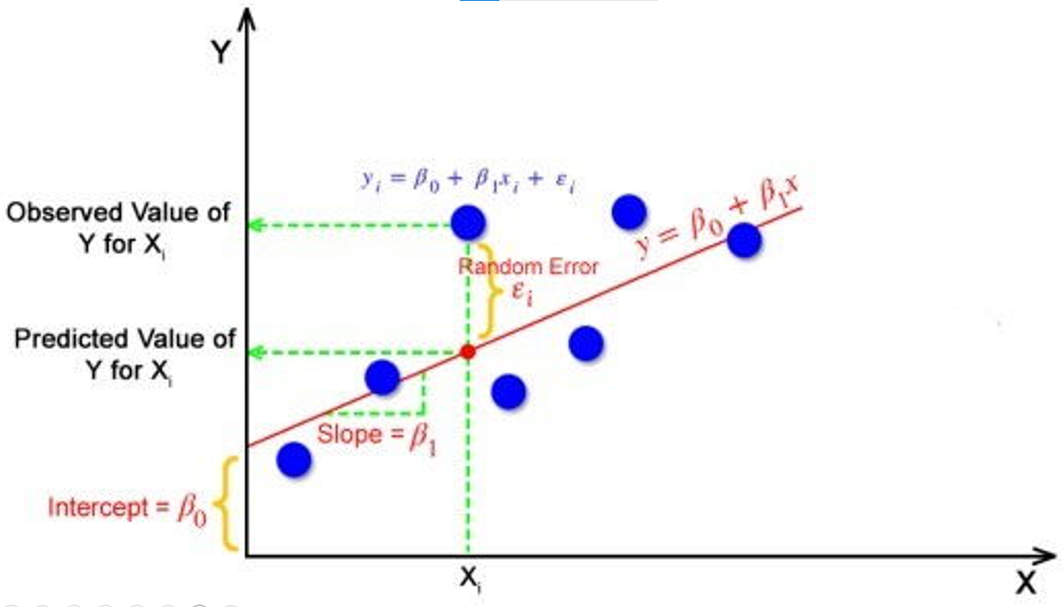
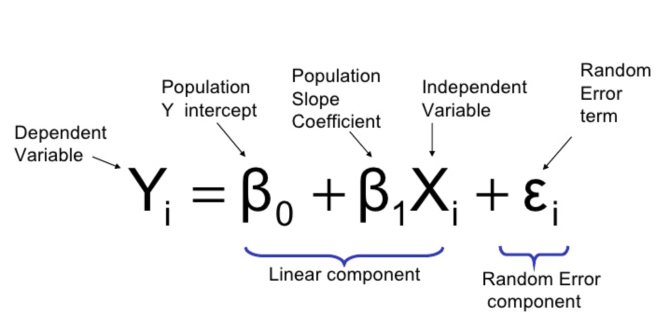
The Regression Equation

Slide 5
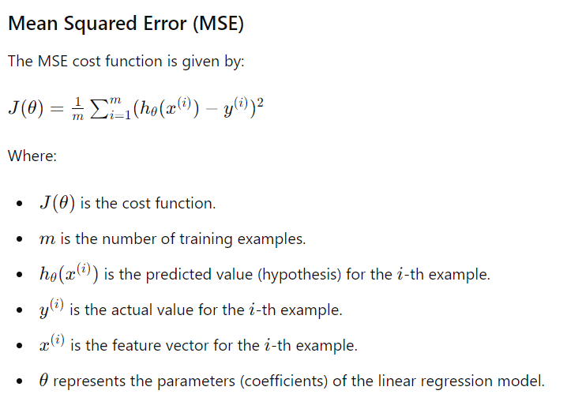
Finding the Best Fit Line
The goal of the linear regression algorithm is to get the best values for B0 and B1 to find the best fit line.
The best fit line is the line that has the least error which means the error between predicted values and actual values should be minimum.
In regression, the difference between the observed value of the dependent variable(Yi) and the predicted value(predicted) is called the residuals.
εi = Y Predicted – Yi
Where Y Predicted = B0 + B1 * Xi
In simple terms, the best fit line is a line that fits the given scatter plot in the best way. Mathematically, the best fit line is obtained by minimizing the Residual Sum of Squares(RSS).

Slide 6
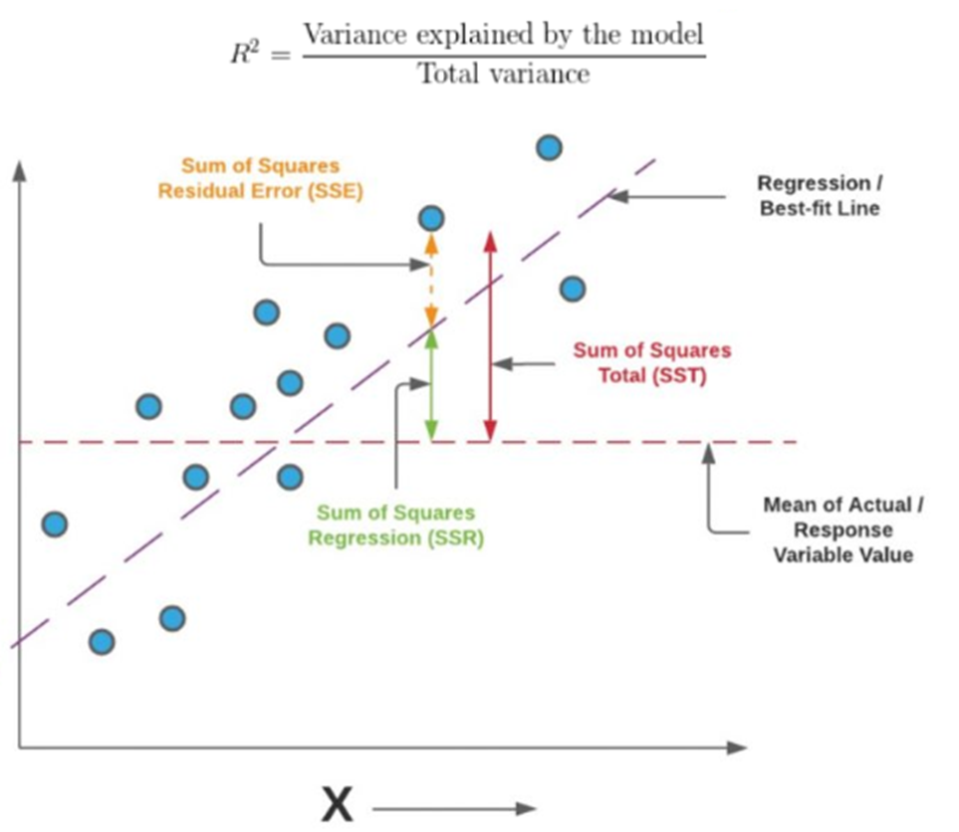
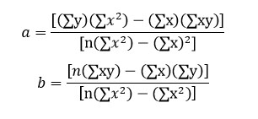
Finding the Best Fit Line

Slide 7
Evaluating the Model
R-squared (The Goodness of Fit): Proportion of variance in the dependent variable that is predictable from the independent variables.
Adjusted R-squared: Modified version of R-squared adjusted for the number of predictors.
F-Statistic: Tests whether at least one predictor variable has a non-zero coefficient.
t-Tests on Coefficients: Each beta coefficient has an associated t-test to determine if the variable is statistically significant.

Slide 8
Linear Regression Example
Scenario: A real estate company wants to predict the selling price of houses based on various features.
Variables:
Price: Selling price of the house (in thousands of dollars).
Size: Size of the house in square feet.
Bedrooms: Number of bedrooms.
Age: Age of the house in years.
Location: Categorical variable indicating the neighborhood quality (1 = Low, 2 = Medium, 3 = High).

Slide 9
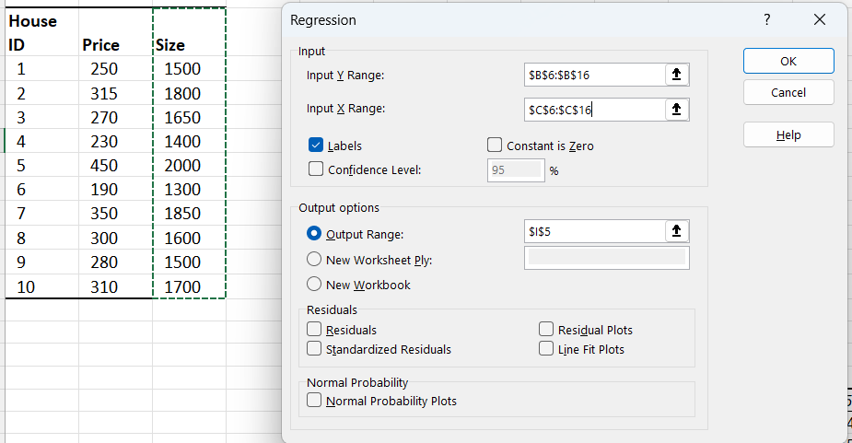
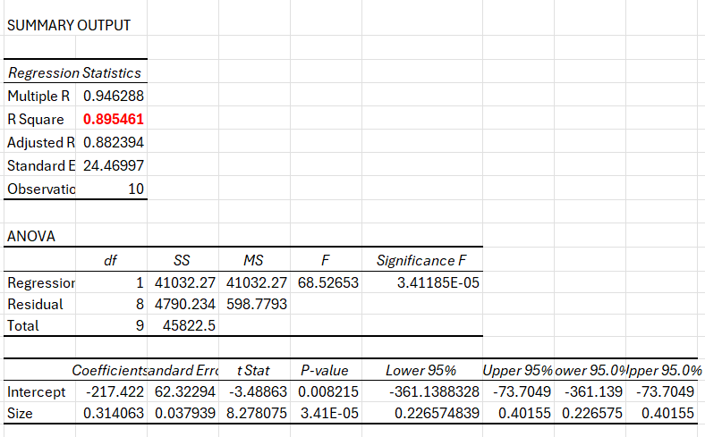
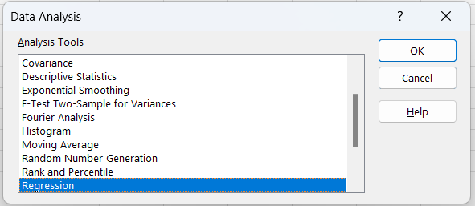
Simple Linear Regression
2
3
1
House ID | Price | Size
1 | 250 | 1500
2 | 315 | 1800
3 | 270 | 1650
4 | 230 | 1400
5 | 450 | 2000
6 | 190 | 1300
7 | 350 | 1850
8 | 300 | 1600
9 | 280 | 1500
10 | 310 | 1700

Slide 10
Regression Statistics
Multiple R (0.946288):
This is the correlation coefficient, showing the strength and direction of the linear relationship between the independent variable (Size) and the dependent variable (Price).
Value close to 1 or -1 indicates a strong linear relationship.
R Square (0.895461):
The coefficient of determination, indicating how much of the variation in the dependent variable (Price) is explained by the independent variable (Size).
In this case, ~89.55% of the variance in price is explained by size.
Adjusted R Square (0.882394):
Adjusted for the number of predictors in the model.
Useful when comparing models with different numbers of predictors; penalizes for adding non-significant predictors.
Standard Error (24.46997):
The standard deviation of the residuals. Smaller values indicate better model fit, as residuals are closer to zero.
Observations (10):
The number of data points used in the regression analysis.

Slide 11
ANOVA (Analysis of Variance):
The ANOVA table tests whether the regression model as a whole is statistically significant.
df (Degrees of Freedom):
Regression: Number of predictors (1) + Intercept (0) = 1.
Residual: Total observations (10) - Number of predictors (1) - 1 = 8.
Total: n−1=9n - 1 = 9n−1=9.
SS (Sum of Squares):
Regression SS (41032.27): Variation in the dependent variable explained by the model.
Residual SS (4790.234): Variation not explained by the model (errors).
Total SS (45822.5): Total variation in the dependent variable.
MS (Mean Square):
Regression MS (41032.27): Regression SS divided by its df: 41032.27 ÷ 1
Residual MS (598.7793): Residual SS divided by its df: 4790.234 ÷ 8
F (68.52653):
The F-statistic, which tests whether the regression model explains a significant proportion of the variation in the dependent variable.
Larger values indicate the model is a good fit.
Significance F (3.41185E-05):
The p-value for the F-test. A small value (e.g., <0.05) indicates the model is statistically significant.

Slide 12
Coefficients Table
Intercept (-217.422):
The value of the dependent variable (Price) when the independent variable (Size) is zero.
Size Coefficient (0.31406):
The slope of the regression line. For every unit increase in size, the price increases by 0.31406 units.
Standard Error (62.32294 for Intercept, 0.037939 for Size):
Measures the variability in the coefficient estimates. Smaller values indicate more precise estimates.
The standard error of a coefficient measures the variability in the estimate of that coefficient if we repeatedly sampled data from the population and fitted the regression model each time.
t Stat (-3.48863 for Intercept, 8.278075 for Size):
The t-test statistic, used to test whether the coefficient is significantly different from zero.
P-value (0.008215 for Intercept, 3.411E-05 for Size):
Tests the null hypothesis that the coefficient is zero (no effect).
A small p-value (<0.05) means the coefficient is statistically significant.
Lower 95% and Upper 95%:
The confidence interval for the coefficient. For example, the coefficient for Size (0.31406) is likely between 0.22657 and 0.40155, with 95% confidence.

Slide 13
Conclusion
The model is statistically significant (Significance F < 0.05), and Size has a significant positive effect on Price (p-value for Size is very small).
The model explains ~89.55% of the variation in Price (R² = 0.895461), which is strong.
The residuals have a standard error of 24.47, indicating the average prediction error.
What Does Standard Error Mean in Regression?
In regression, the standard error (SE) reported in the output refers to the standard deviation of the residuals, also known as the residual standard error (RSE) or simply the "standard error of the regression." It measures how far the observed data points (dependent variable values) are from the predicted values, on average.
In our example, the standard error value indicates that, on average, the predictions made by your regression model are off by 24.47 units (the units of your dependent variable, likely apartment prices).
It tells you how much variability (or error) remains unexplained by your model.

Slide 14
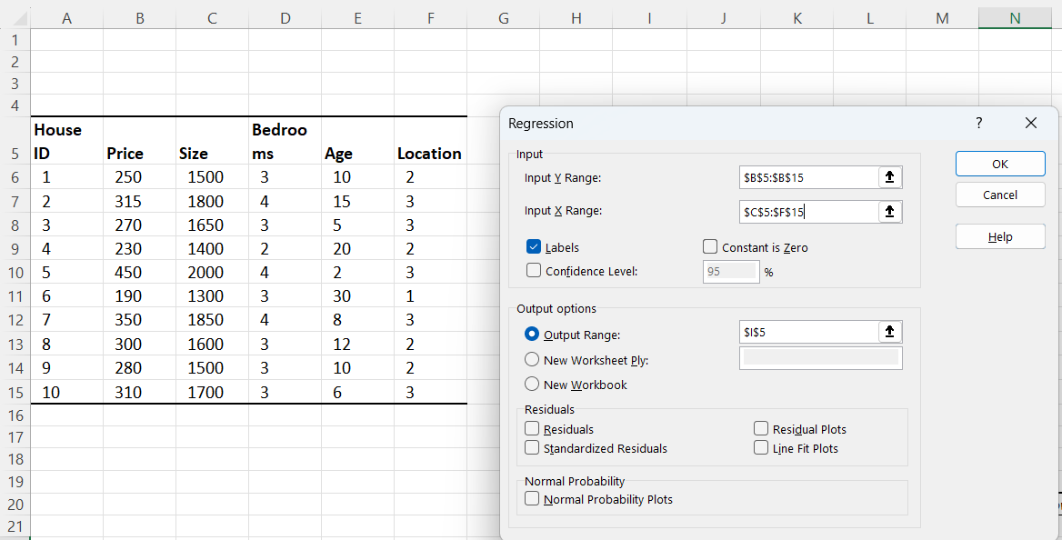
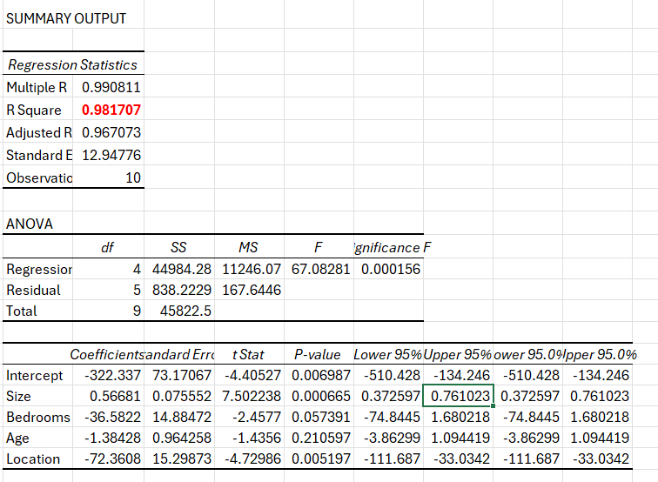
Multiple Linear Regression
2
3
1
House ID | Price | Size | Bedrooms | Age | Location
1 | 250 | 1500 | 3 | 10 | 2
2 | 315 | 1800 | 4 | 15 | 3
3 | 270 | 1650 | 3 | 5 | 3
4 | 230 | 1400 | 2 | 20 | 2
5 | 450 | 2000 | 4 | 2 | 3
6 | 190 | 1300 | 3 | 30 | 1
7 | 350 | 1850 | 4 | 8 | 3
8 | 300 | 1600 | 3 | 12 | 2
9 | 280 | 1500 | 3 | 10 | 2
10 | 310 | 1700 | 3 | 6 | 3

Slide 15
Assumptions of Linear Regression
1. Linearity
The relationship between the independent variables (predictors) and the dependent variable (response) should be linear. This means that the change in the dependent variable is proportional to the change in the independent variable.
Example: If you are predicting house prices (dependent variable) based on the size of the house (independent variable), a linear relationship implies that each additional square foot of the house size increases the price by a constant amount.

Slide 16
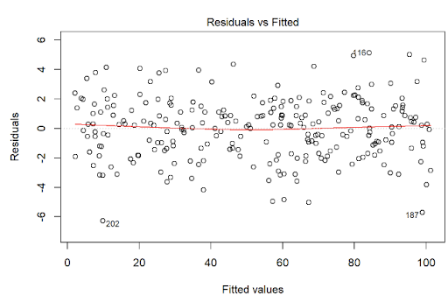
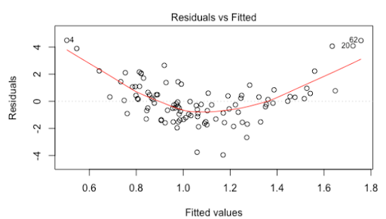
Assumptions of Linear Regression
How to Test Linearity: Plot the residuals vs. predicted using a scatter plot, look for a random distribution (no patterns).
To check if the relationship between the independent variable (Size) and the dependent variable (Price) is linear, we look for patterns in the residuals, a random scatter indicates a linear relationship while curves or trends suggest a non-linear relationship.

Slide 17
Assumptions of Linear Regression
2. Independence
Observations should be independent of each other. This means that the residuals (errors) should not be correlated across observations. This assumption is important for the validity of standard statistical tests.
Example: In a study measuring the effect of a new drug on blood pressure, each patient's measurement should be independent. If measurements from the same patient at different times are used, they are not independent.
How to Test: Use the Durbin-Watson test to check for autocorrelation in residuals, particularly for time-series data. This test calculates a test statistic (range 0-4). A value around 2 indicates no autocorrelation, values <2 suggest positive autocorrelation, and >2 indicate negative autocorrelation.

Slide 18
Assumptions of Linear Regression
3. Homoscedasticity
The variance of the error terms (residuals) should be constant across all levels of the independent variables. If this assumption is violated, it indicates heteroscedasticity, meaning the spread of residuals varies at different levels of the independent variables.
Example: When plotting residuals against fitted values in a regression analysis of apartment prices against apartment size, the spread of residuals should be roughly constant. If residuals spread out more as apartment size increases, this indicates heteroscedasticity.

Slide 19
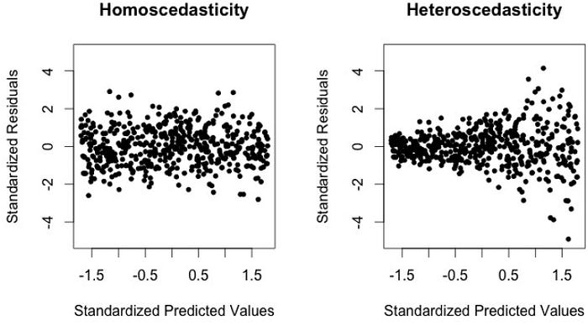
Assumptions of Linear Regression
How to Test Homoscedasticity : Plot residuals vs. predicted values. The spread of residuals variance should be consistent (no funnel-shaped patterns).

Slide 20
Assumptions of Linear Regression
4. Normal Distribution of Errors
The error terms should be normally distributed. This assumption is especially important for small sample sizes because it affects the validity of confidence intervals and hypothesis tests.
Example: After fitting a regression model predicting apartment price based on apartment size, plotting a histogram or a Q-Q plot of the residuals should show that they follow a normal distribution.
Residuals | Standard Residuals | Rank | Percentiles | Theoritical Residuals
-32.890625 | -1.425656831 | 1 | 0.05 | -1.644853627
-30.78125 | -1.334225158 | 2 | 0.15 | -1.036433389
-13.59375 | -0.589226339 | 3 | 0.25 | -0.67448975
-6.484375 | -0.281067736 | 4 | 0.35 | -0.385320466
-3.671875 | -0.159158839 | 5 | 0.45 | -0.125661347
-0.859375 | -0.037249941 | 6 | 0.55 | 0.125661347
7.734375 | 0.335249469 | 7 | 0.65 | 0.385320466
14.921875 | 0.646794429 | 8 | 0.75 | 0.67448975
26.328125 | 1.141202737 | 9 | 0.85 | 1.036433389
39.296875 | 1.703338209 | 10 | 0.95 | 1.644853627

Slide 21
Assumptions of Linear Regression
5. No Multicollinearity
Independent variables should not be too highly correlated with each other. High correlation between predictors (multicollinearity) can inflate the variances of the coefficient estimates and make the model unstable.
Example: In a regression model predicting salary based on education level and years of experience, if education level and years of experience are highly correlated, it could cause multicollinearity issues. Checking the Variance Inflation Factor (VIF) can help detect this.
How to Test: Calculate Variance Inflation Factor (VIF). VIF values above 10 (or sometimes 5) indicate high multicollinearity. A VIF >10 (or sometimes >5) indicates problematic multicollinearity.

